Slide 1

Machine Learning Internship at College Setu (Avricus Pvt Ltd)
By: Nirbhai Verma
2021B3A32316P

Slide 2

Project Title: Dynamic Chatbot using NLP and Machine Learning

Slide 3
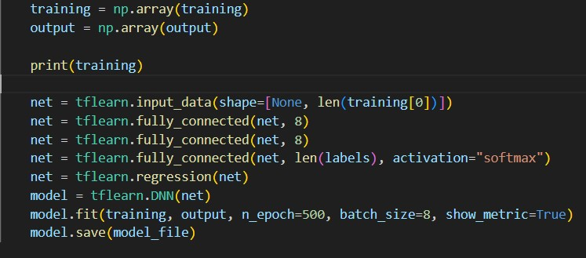

Training the System
Input Layer: The tflearn.input_data() function defines the input layer of the neural network.
Fully Connected Layers: The subsequent lines (tflearn.fully_connected()) add fully connected layers to the network.
Regression Layer: The tflearn.regression() function adds a regression layer to the network.
Training the Model: The model.fit() function is used to train the neural network model

Slide 4
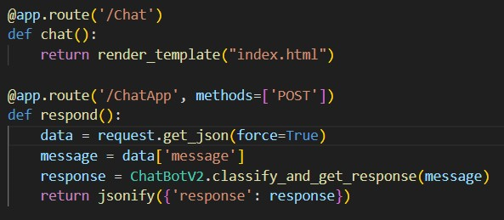
REST API and Server Integration
App.Route(): The @app.route('/') decorator defines a route for the root URL ("/"). When accessed, it returns the string "Working at new route.
The @app.route('/Chat') decorator defines a route for "/Chat". When accessed, it renders the "index.html" template.
The @app.route('/ChatApp', methods=['POST']) decorator defines a route for "/ChatApp" that expects POST requests.

Slide 5
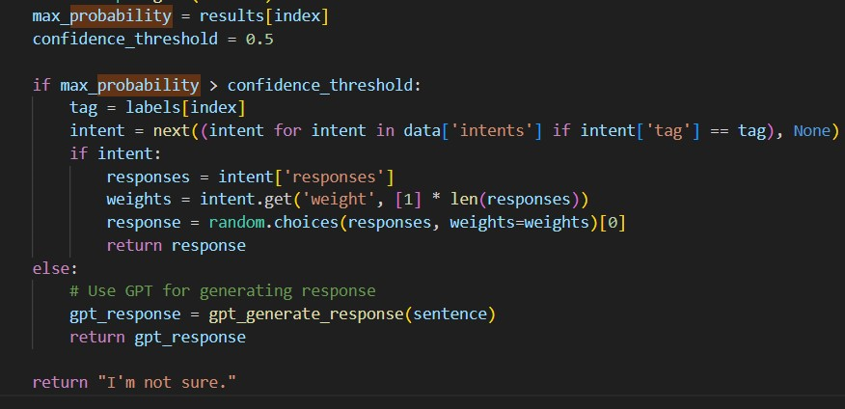
Confidence Level and Model Response
Max_probability
assigns the value at index index in the results array to the variable max_probability.
confidence_threshold
This line assigns the value 0.5 to the variable confidence_threshold and checks if the value is greater than the threshold of 75%
gptResponse
calls a function gpt_generate_response and passes sentence as an argument. It assigns the generated response to the variable gpt_response

Slide 6
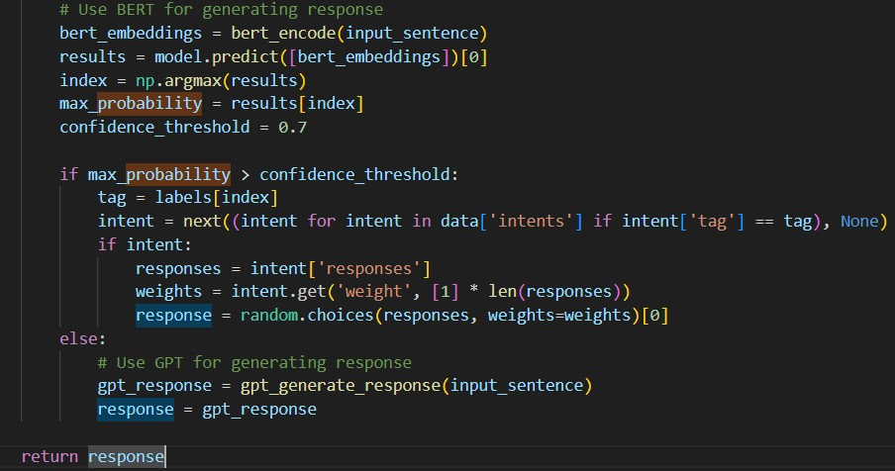
Response Generation Pipeline: BERT and GPT Models
Function: get_response(input_sentence)
Preprocessing: preprocess_input()
Classification: classify_and_get_response()
Response Generation Options:
BERT Model:
Encoding: bert_encode()
Prediction: model.predict([bert_embeddings])
Confidence Threshold: 0.7
Intent Retrieval: data['intents']
Response Selection: random.choices()
GPT Model:
Response Generation: gpt_generate_response()

Slide 7

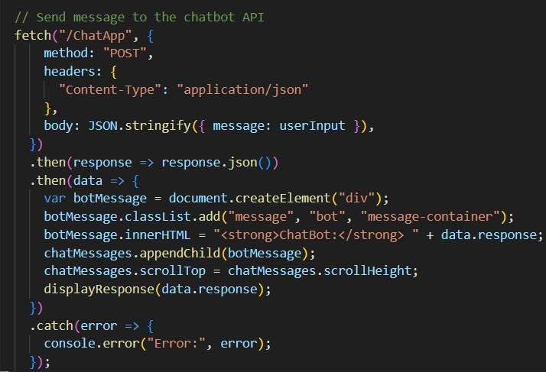
Use of JavaScript for creating the front-end
Fetch API Request: The code initiates a network request using the Fetch API. The target URL is "/ChatApp", indicating that the request is being made to the "/ChatApp" endpoint.
Request Payload: The user's input is sent to the server as a JSON string by using the JSON.stringify() function.
Displaying the Bot's Response: The function displayResponse() is called with the bot's response as an argument, assuming it handles additional logic for displaying the response. The scrollTop property of the "chatMessages" element is adjusted to scroll to the bottom of the container, ensuring the latest message is visible.

Slide 8
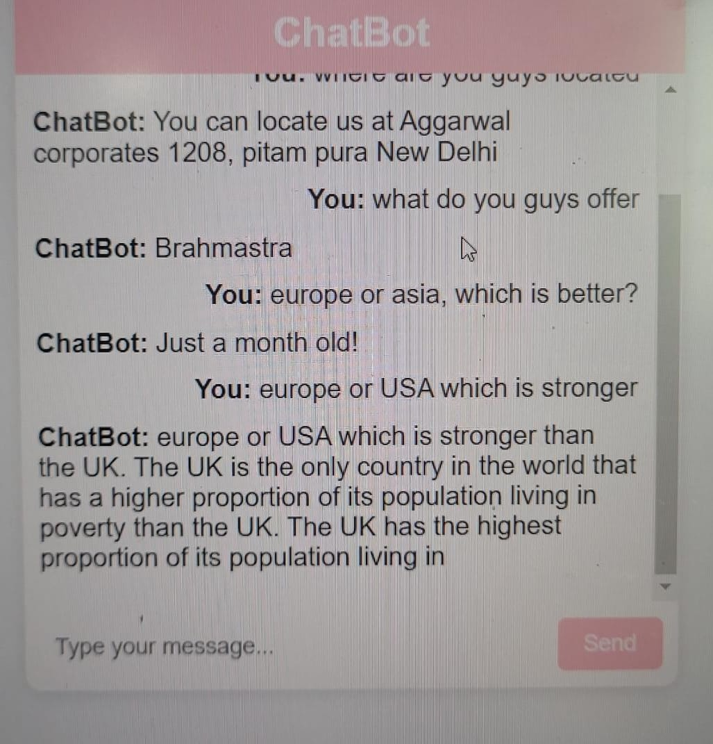
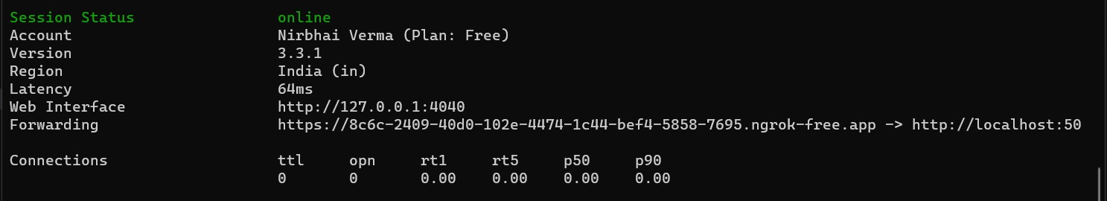
Hosting on Cloud Services: Ngrok
NGROK is a tool that allows you to expose your local web server to the internet.
It creates a secure tunnel from a public endpoint to a locally running web service.

Slide 9

Conclusion & Future Works
Improve Model Interpretability: Work on techniques to interpret and explain the predictions of your model. This can involve methods like feature importance analysis, model-agnostic interpretation techniques
Apply Generative Adversarial Networks (GANs): If your task involves generating realistic data, such as images or text, consider using GANs
Implement Reinforcement Learning:
Explore Transfer Learning

